Slide 1
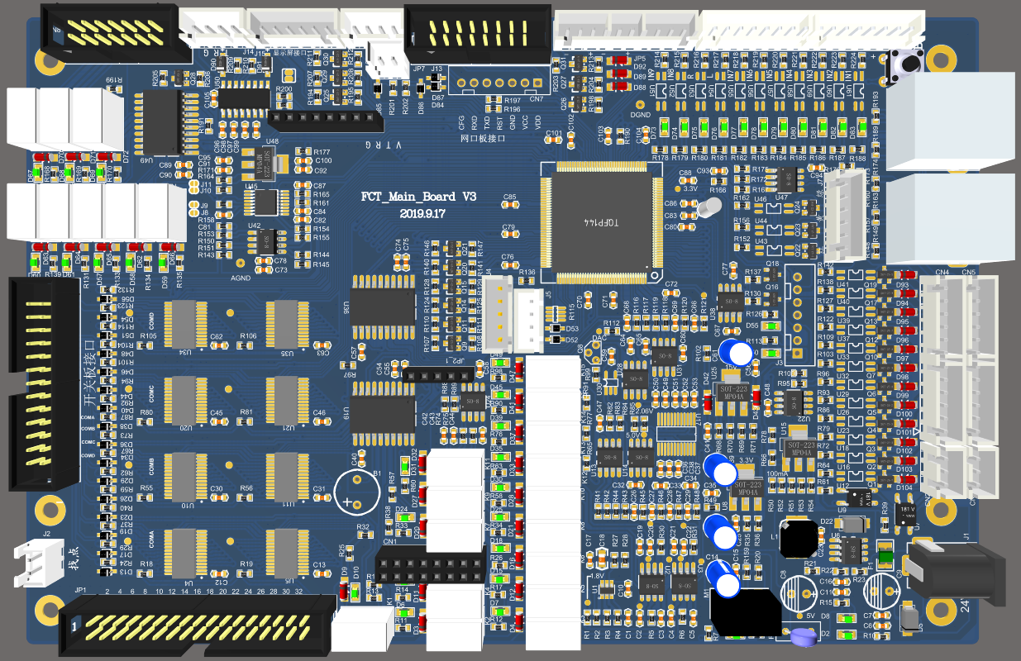
24V
GND
SENSOR 11
GND
SENSOR 10
GND
SENSOR 9
GND
SENSOR 8
GND
SENSOR 7
GND
SENSOR 6
GND
SENSOR 5
GND
上到位传感器 —SENSOR5
下到位传感器 —SENSOR6
光栅传感器 —SENSOR4
GND
SENSOR 1
GND
SENSOR 2
24V
SENSOR 3
GND
24V
SENSOR 4
GND
绿灯 — MOVE17
黄灯 — MOVE16
红灯 — MOVE15
24V
MOVE 17
24V
MOVE 16
24V
MOVE 15
MOVE 12
MOVE 11
MOVE 10
MOVE 9
MOVE 8
MOVE 7
MOVE 6
MOVE 5
MOVE 4
MOVE 3
MOVE 2
MOVE 1
F0NW0323/321主板接线图
24V
下压气缸 — MOVE4
真空吸 — MOVE6
MOVE 14
MOVE 13

